Slide 1


MORINGA School DATA SCIENCE PART TIME CLASS PHASE 1 PROJECT

Slide 2




MICROSOFT movie STUDIO project
Overview
Business Understanding
Next Steps
Recommendations
Data Understanding
Data Analysis

Slide 3
Overview
A presentation to Microsoft PLC management
An analysis of movie data for the past 20 years
Business case for onboarding movie studio
Considerations to be made during decision making
Available options and their implications

Slide 4
Business Understanding
Five data sets reviewed
Box Office Mojo – Source: https://www.boxofficemojo.com
IMDB – Source: https://www.imdb.com
Rotten Tomatoes – Source: https://www.rottentomatoes.com
TheMovieDB – Source: https://www.themoviedb.org
The Numbers – Source: https://www.the-numbers.com

Slide 5
Data understanding
Category and nature of the data used in the analysis :
Titles
Release year
Length
Directors
Actors/actresses
Revenue
Studios
Ratings

Slide 6
Data analysis
Source of insights:
Top rated movie genres
Correlation between top rating and number of votes
Correlation between movie length and rating
Top rated actors/actresses
Top rated directors
Top rated writers
Highest grossing genres
Top studio competitors
Highest profit genres
Studios making most profits

Slide 7


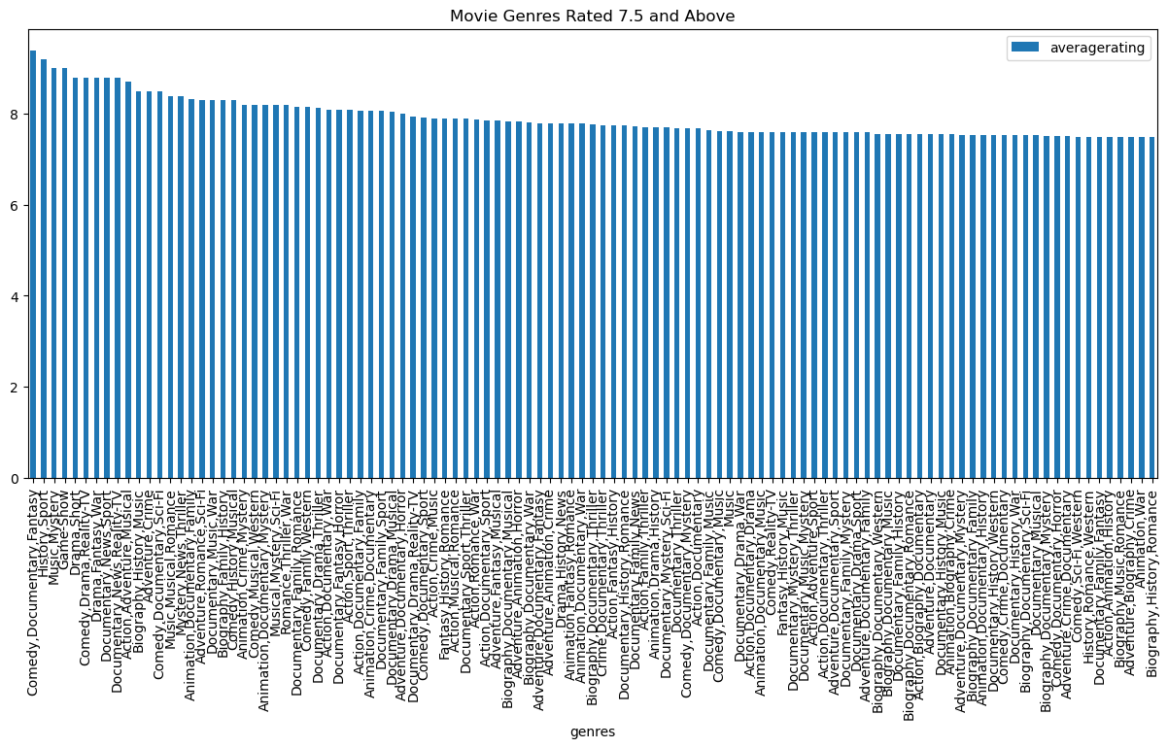



Movie genres to pick from

Slide 8
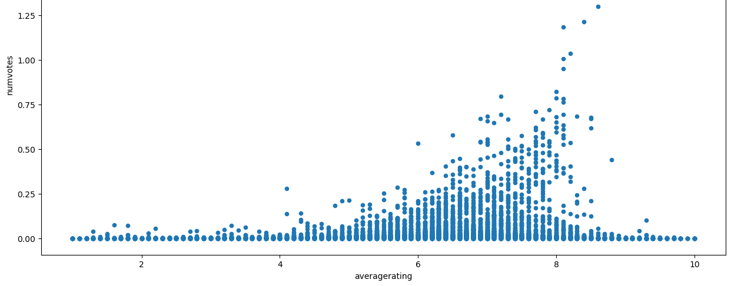
Ratings are directly correlated to number of votes

Slide 9
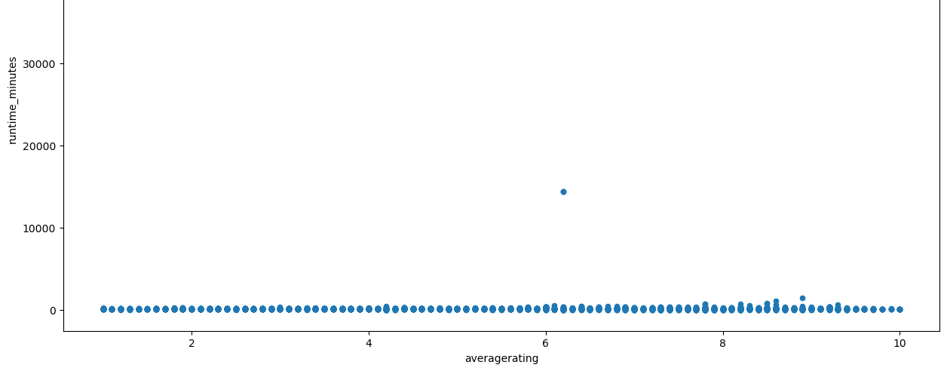
There is no correlation between ratings and length of the movie

Slide 10
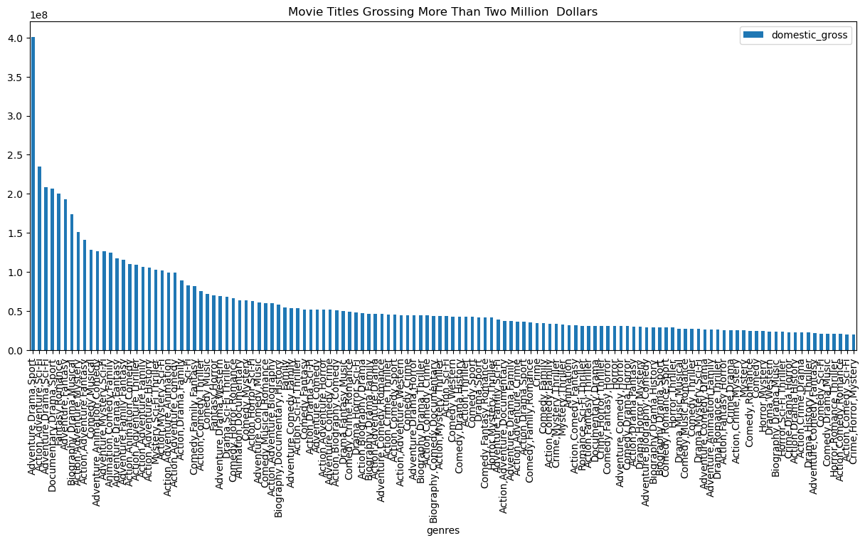
The list of movies grossing high is slightly different from that rated highly

Slide 11
Recommendations
From our list of movie genres whose rating is above 7.5, Microsoft will have a large pool of options to chose from on which to adopt.
Comedy, drama, documentaries being top
Based on the scatter graph of average movie ratings based on number of votes a movie gets, the options are to focus on movies rated 7 to 9 given that they received the highest votes translating to viewership.
The genres grossing the most fall into the action, drama and comedy categories

Slide 12


next steps
Age of Movies: More analysis to be done on the age of reviewed movies
Profits Earned: Correlation to be garnered on high grossing movies against highly rated movies
Actors and Earnings: Establish whether top rated actors based on movie ratings, also result in higher profits
Job Titles: Confirm the relationship between actors/ actresses, directors, writers and movie performance

Slide 13

Thank You
LABAN.KARIUKI@STUDENT.MORING.com
labankihara@gmail.com
Linkedin
Github:a
+254720475650

